Slide 1
Data Structures
Carrano & Henry,
Intro & Prelude
Topic 1 – Introduction / Review of Object-Oriented Principles

Slide 2
Why Care About Data Structure
Involves the storing and managing of data so that it can be used
Computer science relies on the manipulation of data
Choice of data structure can make a big difference in the efficiency of an algorithm and operation of a program
We also organize data in real life
To-Do Lists
Folders, directories
Stacks of books
Dictionaries and Libraries
Standing in line

Slide 3
Why Care About Data Structure
More complex programs require the use of more data – which places a greater emphasis on how data is managed
Processing speed
Data searching
Handling multiple requests

Slide 4
Why Care About Data Structure
The proper data structure can provide several benefits
Efficient memory usage (e.g., linked lists vs. arrays)
Reusability
Abstraction (create a generalized template that can be realized in implementation)

Slide 5
Examples
List
Stack
Queue
Tree
Bag
Dictionary
Graph

Slide 6
Java and Object-Oriented Principles
OOP allows the programmer to organize around objects – what they represent, what their characteristics are, and what functions can be performed on them
So key OOP concepts to remember:
Encapsulation
Abstraction
Inheritance
Polymorphism

Slide 7
Encapsulation
The practice of enclosing data and methods within a class
Provides information hiding – properties can be declared private
Controls data – can impose restrictions on how data can be manipulated (e.g., setters to allow only permissible range of values)
Organizes into separate modules
Programmer only receives enough information to use the class

Slide 8
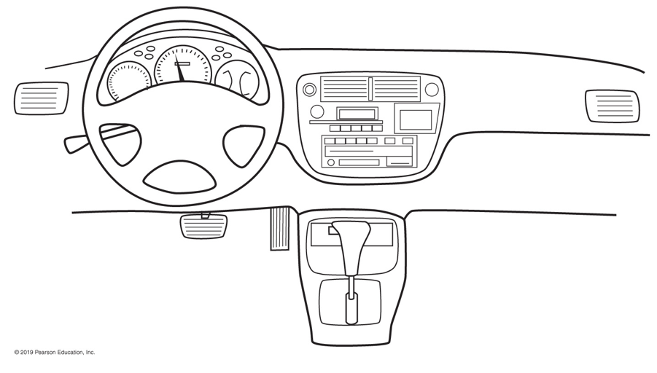
Encapsulation
How is this an example of encapsulation?

Slide 9
Abstraction
Data abstraction is the process of hiding certain details and showing only essential information to the user
Allows to focus on what instead of how
Just plan out what needs to be done
Worry about the implementation later
Divide into two distinct parts
The client interface
The implementation

Slide 10
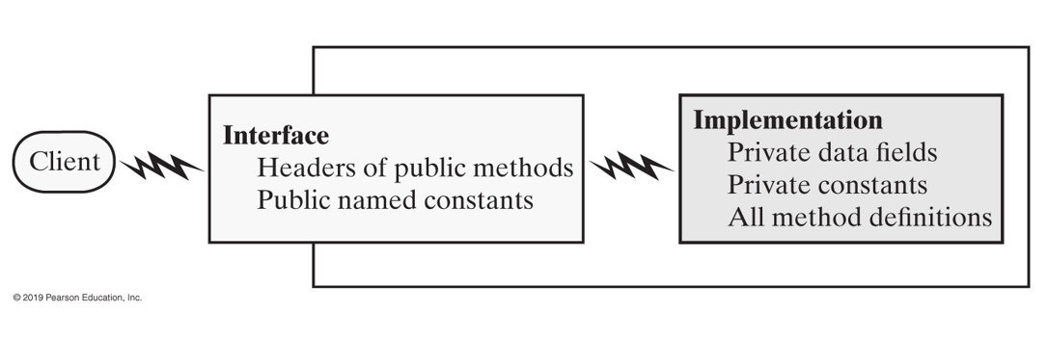
Abstraction

Slide 11
Abstraction
It is important to specify pre- and post-conditions for methods
Preconditions state what must be true before the method executes
Client should make sure that preconditions are met before using method
Postconditions explain what is true after the method executes
Should use assertions, either in comments or with assert statement

Slide 12
Java Interfaces - Measurable
// An interface for methods that return // the perimeter and area of an object
public interface Measurable { /**Gets the perimeter @return the perimeter.*/ public double getPerimeter(); /**Gets the area @return the area.*/ public double getArea(); } //end Measurable

Slide 13
Java Interfaces
Acts as a template that declares a number of public methods
Any class that implements the interface must provide its own definition of the declared methods
Interface should include comments/documentation to inform the programmer
Any data properties declared in interface should be public, final, and/or static (i.e., public-facing)
A Java interface can be treated as a data type (e.g., you can declare a variable to be of type Measurable)
This indicates the variable can invoke the set of methods declared in the interface (and only those methods)

Slide 14
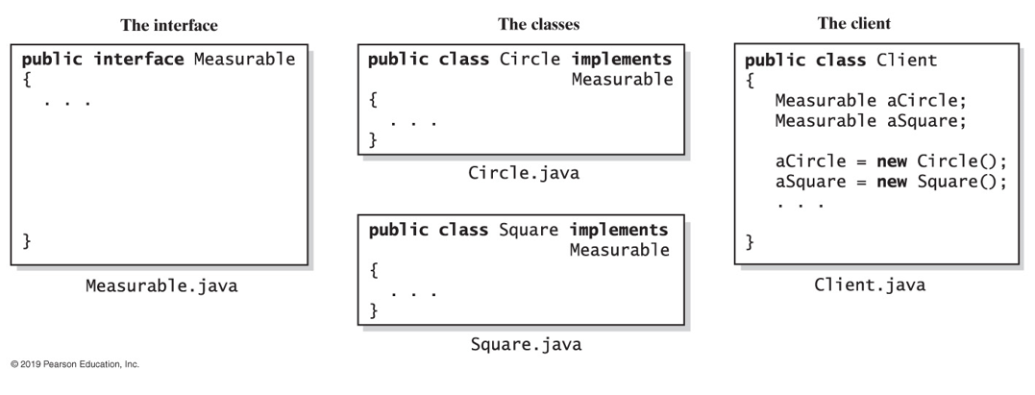
Java Interfaces
Several classes can implement the same interface
A class can implement more than one interface

Slide 15
Java Interfaces
Interfaces are organized around functionality
Contrast to abstract classes, which are organized around the properties of the objects
Abstract classes are useful if you want to provide a method definition or declare a private data property that the classes will have in common
But a class can extend only one abstract class

Slide 16
Designing Classes
As the programs you write become more complex, you will need to plan out and design your classes before you code
Some things to consider:
Who or what will use the system?
What can each actor do with the system?
Which scenarios involve common goals?
Example: Suppose we want to develop a registration system for a school

Slide 17
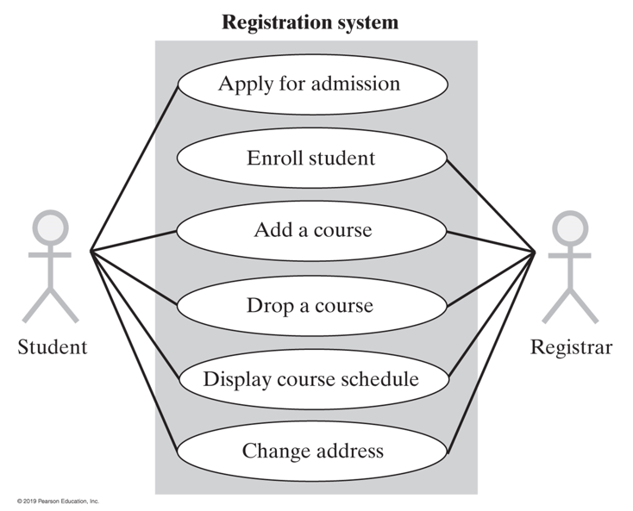
Use Cases
A good starting point is to create a use case diagram that identifies various "actors" and what each actor can do with the system
You want to identify the different actors, the different uses, and overlaps in use

Slide 18
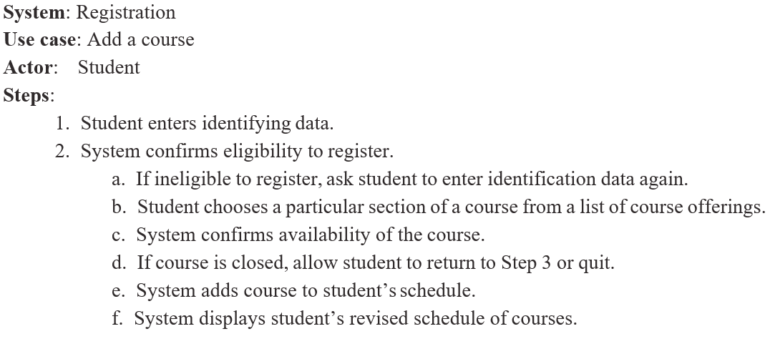
Use Cases
Each use case should be further developed to outline a list of steps that will be followed for the actor to perform the use case

Slide 19
CRC Cards
CRC model is a way of organizing by identifying class, responsibilities, and collaborators
CRC cards are created for each class, identifying the class's responsibilities (something it knows or does) and collaborators (a class that interacts to fulfill the responsibilities)
CRC cards are used in a development process called extreme programming, but it is useful to emphasize object-oriented principles and to plan out classes

Slide 20
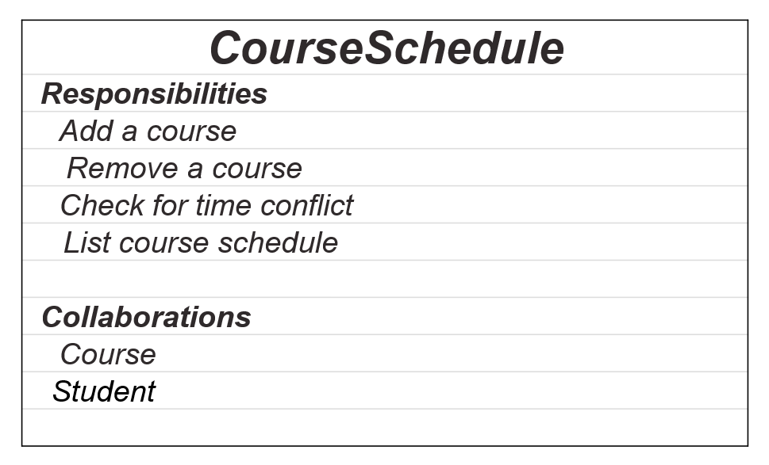
CRC Cards

Slide 21
Unified Modeling Language (UML)
UML is a useful tool for depicting the organization of objects (among other things)
Basic class diagrams can depict
What classes there are
The data attributes and functions for each class
The hierarchy and/or relationships among classes

Slide 22
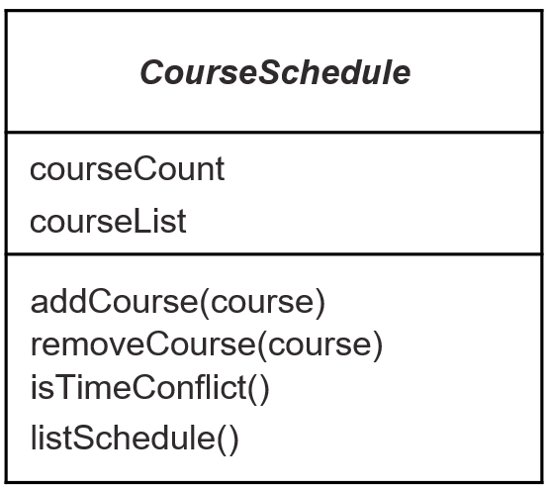
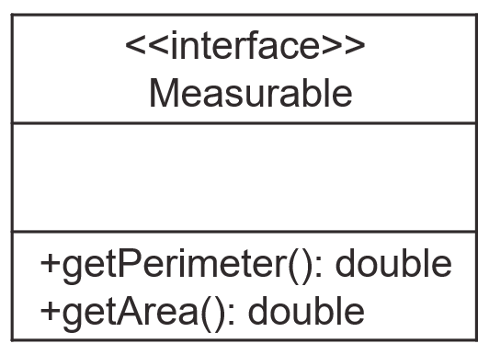
Unified Modeling Language (UML)

Slide 23
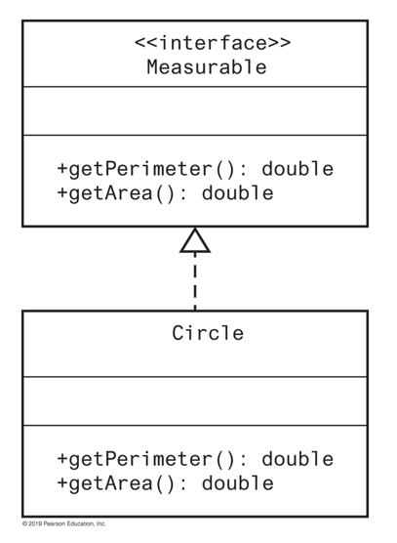
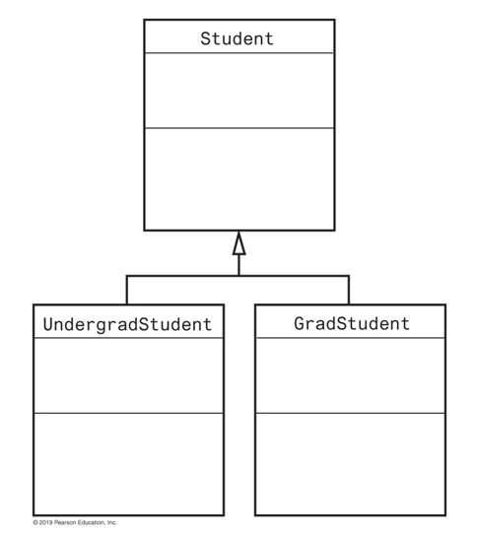
Unified Modeling Language (UML)

Slide 24
Reusing Classes
Remember that not all classes are designed and written from scratch
Most software is created by combining already existing components with new components
This saves time and money
Reused components that are already tested
Don't reinvent the wheel!

Slide 25
Reusing Classes
Same principle applies to data structures
We'll cover some of the common data structures, each with their own characteristics and advantages/disadvantages
Based on the needs of your project, you can choose the structure(s) that work best without having to design from scratch

Slide 26
Generic Data Types
One feature of Java that facilitates generalized data structures is the generic data type
Allows a placeholder instead of an actual class type
Create by declaring a generic data type AND a type parameter <T>
When it is used, an actual data type is chosen to fill the placeholder

Slide 27
Generic Data Types
Example – Pairable.java
//An interface for pairs of objects
public interface Pairable<T> { public T getFirst(); public T getSecond(); public void changeOrder(); }

Slide 28
Generic Data Types
This allows you to create a generalized data structure that can hold any type of object
The data structure operations can be defined without reference to the specific type of data it holds
Abstraction!
Don't think that you're building a List of __.
Think that you are building a List. And you can use this List to hold ___.

